Slide 1
Application Security
Basics, Trends & Vulnerabilities
Alok Tiwari, Senior Technical Director, NIC, Lucknow

Slide 2
Agenda
        Application Security, basics & trends
        Cyber Security - Intro
        Database Security - Intro
        Best Practices – AS & CS
Notes:
Explain all the 4 Topics

Slide 3

Interesting Facts
Now a Developer is treated like a person who can write a code, which is complaint with
  Customer requirements fulfillment
  Should be fast & Usable interface
  The code should be comprehensive and extensible
  Secured, Stable & Reliable
  Optimize the database queries
  Maintain a delivery pipeline
  At Last code should be safe !!!
Expectations

Slide 4


Two Interesting facts
Performance – can be quantified
Security – difficult to quantify

Slide 5
Trends - I
Trends - I
Advancements in web applications, web services and other technology have changed the way we do business and access and share information. Many businesses have shifted most of their operations online so employees from remote offices and business partners from different countries can share sensitive data in real time and collaborate towards a common goal.
Everything is demanded online; starting from online banking to online shopping, which is pushing all data towards vulnerability.
As everything is demanded online, hence it is giving the birth of a new industry i.e. Application Security.
Change in doing business
Notes:
test1

Slide 6
Trends - II…
Trends - II
Hundreds of tools are available to secure various elements of applications portfolio,
  from locking down coding changes
  to assess inadvertent coding threats
  evaluating encryption options
  auditing permissions and access rights.
  tools for mobile apps, for network-based apps
  firewalls designed especially for web applications.
Gartner also says that
“IT managers need to go beyond identifying common application development security errors and protecting against common attack techniques.”
They offer more than a dozen different categories of products and describe where in their “hype cycle” they are located.”
IT managers Lack in knowledge
Notes:
Hundreds of tools are available to secure various elements of applications portfolio, from locking down coding changes to assessing inadvertent coding threats, evaluating encryption options and auditing permissions and access rights. There are specialized tools for mobile apps, for network-based apps, & for firewalls designed especially for web applications.

Slide 7
Trends – III …
Trends - III
In year 2018 & 2019 we are seeing a large increase of in number of application vulnerability.
Majorly they were related to
  Injection (sql/object/command injection)
  On CMS (wordpress & drupal)
  IoT vulnerabilities
  Weak Authentication
  API Vulnerabilities Slowly
Look around for the environment about the Applications and softwares

Slide 8



Todays business needs are changing very fast & hence the deployments and releases.
2020+
d
2015
App
App
2010
App
App
Number of Applications
Release Frequency
Notes:
All in all, every business is releasing vulnerabilities 10x faster.
Every business is a digital business. Businesses today rely on data to run and applications to interface with customers and partners. As a result, there has been tremendous growth in the number of web and mobile applications and increasing frequency of application releases.
Additionally, the complexity of code has increased as developers try to meet the demand by utilizing open source and commercial code in addition to custom code.
In our 2017 Application Security Research Update:
30X more deployments of apps over last year
Apps are getting more complex with 83% of them utilizing open source components in addition to custom code and COTS

Slide 9
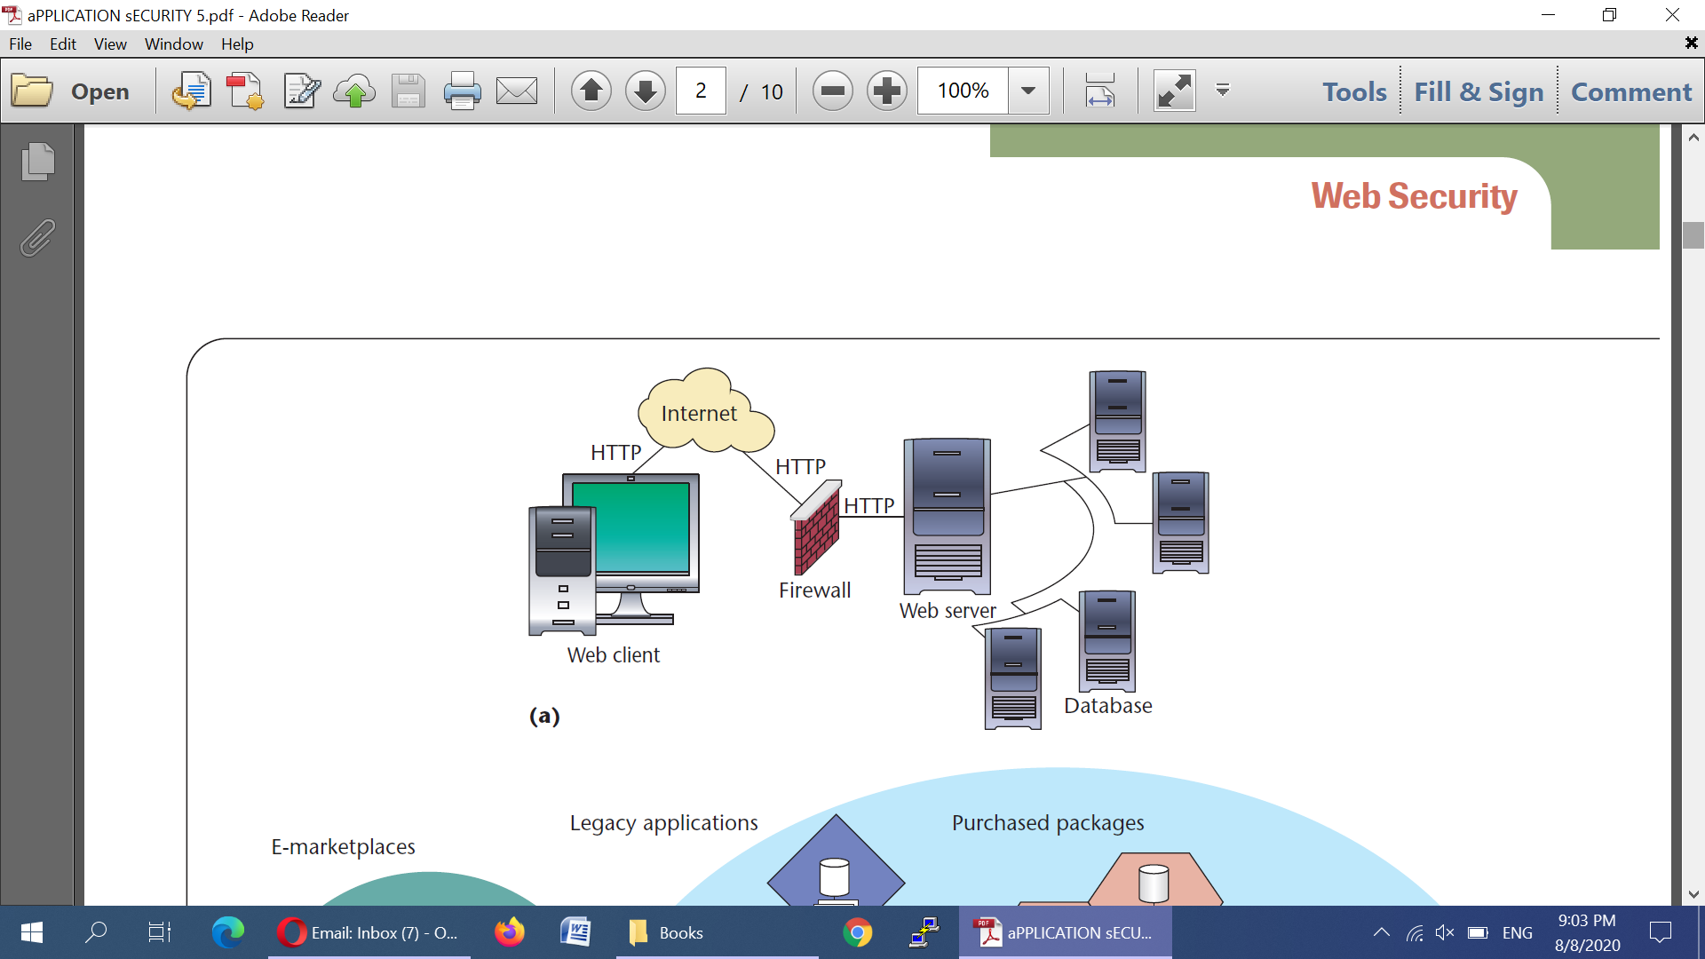
The environment which we think

Slide 10
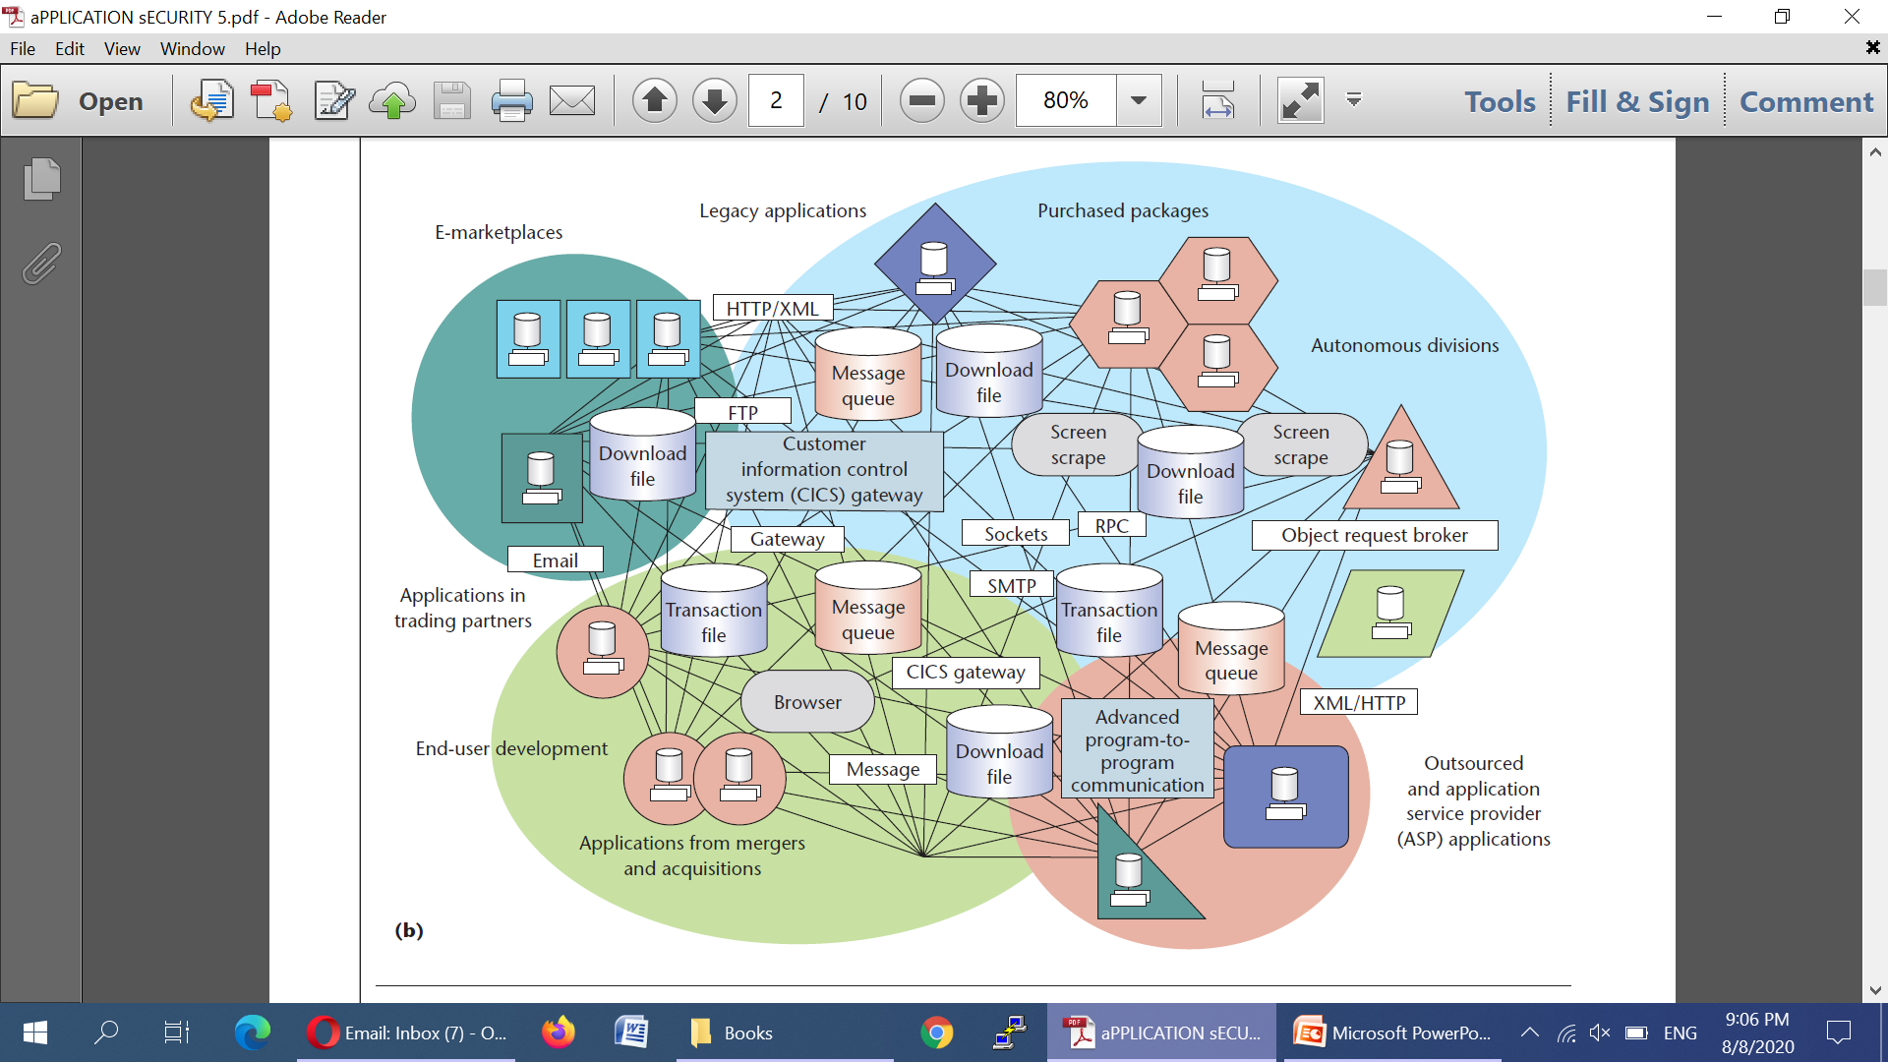
Actual Environment with Internet

Slide 11
Application Security is very Complex in todays world
Monitoring / Protecting Production Software
Demonstrating Compliance
Certifying new releases
Securing legacy applications
Legacy Software
In-house Development
Procuring secure software
Outsourced
Commercial
Open Source
Notes:
To further compound the problem, the number and complexity of applications is growing. Ten years ago the software security challenge was about protecting static websites that were fairly innocuous and easy to scope and protect. Now, the software supply chain is much more complicated considering the outsourced development, the number of legacy applications, coupled with in-house development that takes advantage of 3rd party, open source and commercial, off-the-shelf software. In the context of that supply chain and how modern applications are built, the security threat becomes even more complex to tackle for most security organizations.
Life of a sw dev –
New Features/Functionality
Increase complexity
Increase # of apps
Deadlines, Overwhelmed, Product Delays
Agile/DevOps enviro
Challenges:
SW is coming from (legacy, outsource, in house, open source, 3rd party)
Secure the sheer # of app is mind-blowing, co’s cannot keep up
Complexity of apps and threats have increased
Co depend on apps to run it’s bus & they’re under pressure to drive innovation & value to stay competitive & meet customer expectations.
DevOps – Sec backseat
Ability to secure & control these apps is slipping away from sec groups/teams
There are two approaches that an org can take…

Slide 12
From where attacks can happen

Slide 13
Two Attacks on Application Security Layer
The WanaCry Attack in May 2017
The Marriott Attack in 31st March 2020
Attacks
we(Developer) should understand
Notes:
The WannaCry ransomware attack was a May 2017 worldwide cyberattack by the WannaCry ransomware cryptoworm, which targeted computers running the Microsoft Windows operating system by encrypting data and demanding ransom payments in the Bitcoin cryptocurrency. It propagated through EternalBlue, an exploit discovered by the United States National Security Agency (NSA) for older Windows systems.
On March 31, 2020, Marriott posted an announcement that "an unexpected amount of guest information may have been accessed using the login credentials of two employees at a franchise property." That "unexpected amount" turned out to be the data of 5.2 million guests. We know that a hacker obtained the credentials of two employees at a Marriott property and used them to siphon data for roughly a month before being discovered. We don't know how that hacker obtained employee credentials, but credential stuffing and phishing are both likely culprits.

Slide 14
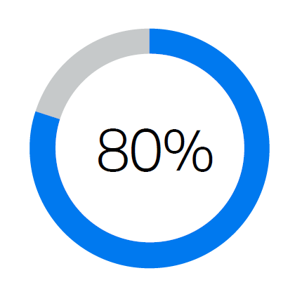
Vulnerabilities
90%
Security incidents from exploits against defects in the design or code of software.
Percentage of applications containing at least one critical or high vulnerability.

Slide 15
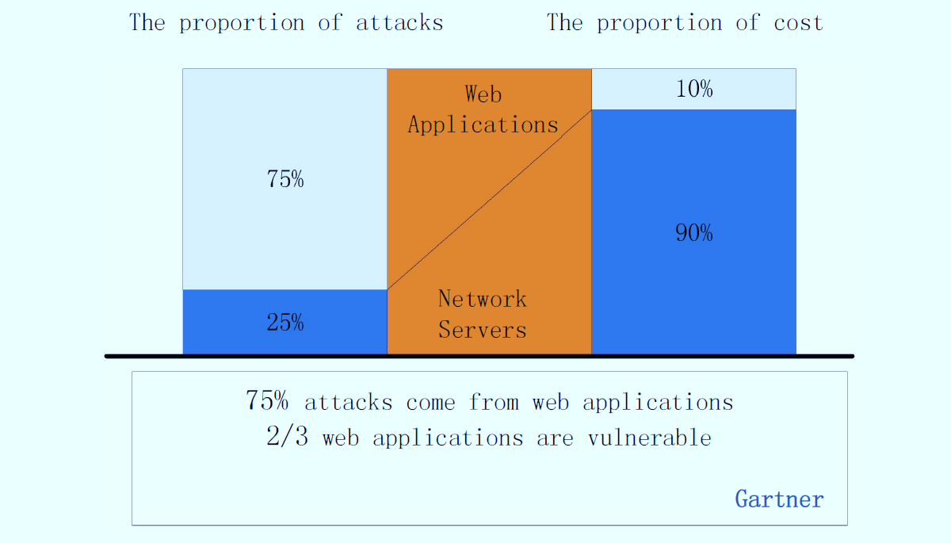
Current Statistics

Slide 16
What is Cyber Security

Slide 17

Network Security
(Rules for web access and equipment config)
Data Center (Internet and traffic access rules)
Application Security
White Box, Black Box, Manual etc
Servers & Storage Security of Servicers
Security of Storage and others
DMZ Area (Outside & Inside of farm area)
System Software & Databases
Patches, updates for both
What is Cyber Security
Definition
    When security term is used it is understood that we are talking about the cyber security. We actually have the differences, Just see t his diagram. It is composed of …

Slide 18
Hence, Administrators Should
Database Log Analyzer provides predefined database specific security reports that help in visualizing the exact events that had happened. It helps on SQL Injection and Denial of Service.
Web/Application Log Analyzer lets you identify the attack attempts at the earliest with its real-time email/SMS alert notifications.
Checks available reports and also send SMS/Alerts
SQL Injection report | Account lockouts reports| Denial of Service report | Expired passwords report
Database Monitoring & Server access logs along with denials
Monitor and track operations occurring within database like lock/unlock of rows/tables/database.

Slide 19
What is Application Security

Slide 20
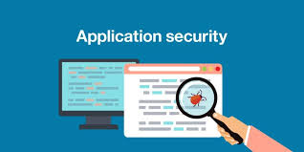
What is Application Security
Definition
    Application Security is the process of making apps more secure by finding, fixing, and enhancing the security of applications. Now a days it is very important as the hackers are targeting not the network but the applications.
Client based Application
Browser based Web application
Mobile based Application
Integrations and its rules of access
Encryption standards(AES/DES)
These vulnerabilities are talked by programmer at different stages as follows …
    Design Upgrade
    Development Maintenance
    Deployment

Slide 21
Why Application security is important ?
Evolution
Application security is important because today’s applications are often available over various networks and connected to the cloud/DC, increasing vulnerabilities to security threats and breaches.
There is increasing pressure and incentive to not only ensure security at the network level but also within applications themselves.
Application security testing/auditing can reveal weaknesses at the application level, helping to prevent different attacks.
Web application security applies to web applications—apps or services that users access through a browser interface over the Internet.

Slide 22
Application Security Challenges
One have to keep up with the evolving security and application development tools & market changes.
It also has to anticipate the business needs as more enterprises dive deeper into digital products and their application portfolio needs evolve to more complex infrastructure. They also have to understand how SaaS services are constructed and secured. This has been an issue, as a recent survey of 500 IT managers has found the average level of software design knowledge has been lacking.
The report states, “CIOs may find themselves in the hot seat with senior leadership as they are held accountable for reducing complexity, staying on budget and how quickly they are modernizing to keep up with business demands.”

Slide 23
Center of Application Security Lucknow

Slide 24


Center of Excellence, Application Security ,
Lucknow
States allotted to UP
  ** only four members are working in CoE.
Application Auditing
  Black Box testing
  White Box testing
  Manual Audit
  Third Party Audited Sites’ clearance
  Static/ Self-Assessed Sites’ Audit clearance
Penetration Testing On the production servers PT is done and tickets are opened and being monitored.
UP
Uttrakhand
Punjab
Haryana
Chandigarh
Jammu & Kashmir
HP

Slide 25
Center of Excellence,
Application Security , Lucknow
Application Security Auditing
Application security encompasses the measures taken to improve the security of an application ( later many people call it as website/portal) by
    Finding
    fixing
    Preventing security vulnerabilities
IBM Tools are used
OWASP Top 10 (open web Application security Project)
CWE Vulnerabilities – 25 (Common Weakness Enumeration)

Slide 26
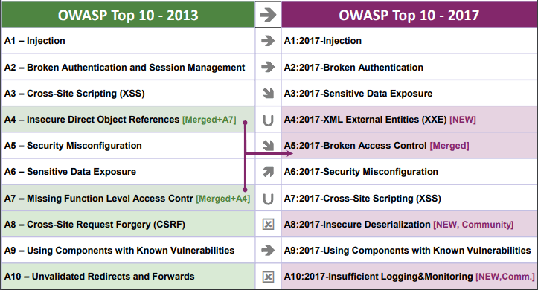
OWASP 2017

Slide 27
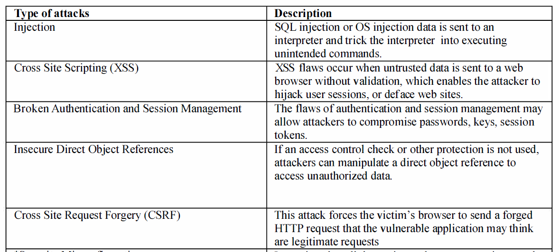
OWASP A1-A5

Slide 28
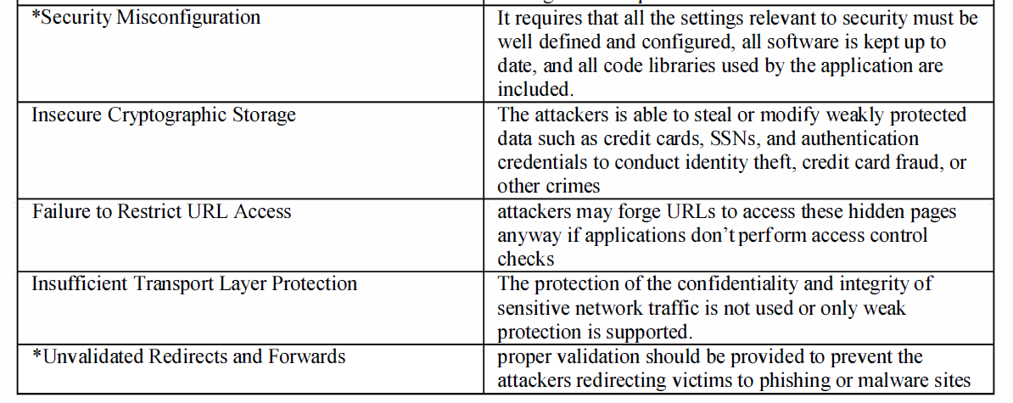
OWASP A6-A10

Slide 29
Interesting Myths(AS)
We have a Secure Network Firewall
  Network firewalls cannot analyze web traffic sent to and from the web applications, therefore it can never block any malicious requests sent by someone trying to exploit a vulnerability such as an SQL injection or Cross-site Scripting.
We scan our Servers and Network with a Network Security Scanner
  Network security scanners are designed to identify insecure server and network device configurations and security vulnerabilities and not web application vulnerabilities
Web Application Firewall is meaning less.
    WAF does analyse both HTTP and HTTPS web traffic, hence it can identify malicious hacker attacks because it works at the application layer.

Slide 30
Interesting Myths(AS)
WAF works as good administrator it will correct the flaw
  Interesting, but, It is correct, it detects, stops but will not correct the code.
WAF is a Normal Application that can not have Vulnerabilities
  A web application firewall is a normal software application that can have its own vulnerabilities and security issues. Over time many security researchers identified several vulnerabilities in web application firewalls that allow hackers to gain access to the firewall's admin console, switch off the firewall and even bypass the firewall.

Slide 31
Application Security trends
The Veracode report# – 2019 shows that the most common types of flaws are:
  Information leakage (64%)
  Cryptographic issues (62%)
  CRLF injection (61%)
  Code quality (56%)
  Insufficient input validation (48%)
  Cross-site scripting (47%)
  Directory traversal (46%)
  Credentials management (45%)
Percentage shows the no of infected application to the tested applications.
# Veracode Report summarizes the security flaws identified during this scan.

Slide 32
Application Security Trends
Applications security development is having good progress graph. The number of web application vulnerabilities continues to grow, but the growth is slowing.
That's due to primarily to a decline in
  IoT vulnerabilities--only 38 new ones reported in 2018 versus 112 in 2017.
  API vulnerabilities, on the other hand, increased by 24% in 2018, but at less than half the 56% growth rate of 2017.
Content Management Systems, Wordpress in particular. That platform saw a 30% increase in the number of reported vulnerabilities. Drupal content management system is becoming a target for attackers because of two vulnerabilities: Drupalgeddon2 (CVE-2018-7600) & Drupalgeddon3 (CVE-2018-7602). (related to back-end databases).

Slide 33

Learning's …
  It is seen that some organisations are using only scanning tools for the application security.
  Web application security scanners can only identify technical vulnerabilities, such as SQL Injection, Cross-Site Scripting, Remote Code execution etc. Therefore
    an automated web application security scan should always be accompanied by manual audit to identify logical vulnerabilities.

Slide 34
Application Security Tools
  Security
  Testing Tools
Application
Shielding Tools
  Popular tools like IBM, Microfocus, CA

Slide 35
Security Testing Tools
Gartner categorizes the security testing tools into several broad buckets like:
  Static Testing, which analyzes code at fixed points during its development. This is useful for developers to check their code as they are writing it to ensure that security issues are being introduced during development.
  Dynamic Testing, which analyzes running code. This is more useful, as it can simulate attacks on production systems and reveal more complex attack patterns that use a combination of systems.
  Interactive Testing, which combines elements of both static and dynamic testing.
  Mobile Testing is designed specifically for the mobile environments and can examine how an attacker can leverage the mobile OS and the apps running on them.

Slide 36
Security testing tools
We have different trade offs for the application security findings and the redressal suggestions.
  White box Security Audit : This is also termed as code review. The security engg deeply understands t he code manualy and notifies the flaws in the application.
  Black box Security Audit : This is only through use of application testing and the source code is not required.
  Design Review : SRS & SDD document
  Tooling : with the help of different open source tools you can find/test flaw in the application.
  Penetration Testing : With the help of free tools we try to penetrate the application in the live stage.

Slide 37
Application Shielding tools
  Another issue is whether any tool is isolated from other testing results or can incorporate them into its own analysis. IBM’s is one of the few that can import findings from manual code reviews, penetration testing, vulnerability assessments and competitors’ tests.
  The main objective of these tools is to harden the application, so that attacks are more difficult to carry out. Here you’ll find a vast collection of smaller, point products that in many cases have limited history and customer bases. The goal of these products is to do more than just test for vulnerabilities and actively prevent the apps from compromise/corruption.

Slide 38
Application Shielding tools
Runtime application self-protection (RASP): These tools could be considered a combination of testing and shielding. They provide a measure of protection against possible reverse-engineering attacks. RASP tools are continuously monitoring the behavior of the app, which is useful particularly in mobile environments when apps can be rewritten, run on a rooted phone or have privilege abuse to turn them into doing nefarious(criminal) things. RASP tools can send alerts, terminate errant processes, or terminate the app itself if found compromised.
Code obfuscation(unclear): Hackers often use obfuscation methods to hide their malware, and now tools allow developer to do this to help protect their code from being attacked.

Slide 39
Application Shielding tools
Encryption and anti-tampering tools: These are other methods that can be used to keep the hackers from gaining insights into your code.
Threat detection tools: These tools examine the environment or network where your apps are running and make an assessment about potential threats and misused trust relationships. Some tools can provide device “fingerprints” to determine whether a mobile phone has been rooted or otherwise compromised.

Slide 40
Best Practices
B1-B5

Slide 41
Best Practices for Cyber Security – B1
Harden all devices
Use Least privilege user access
Enforce effective password management policies
Conduct regular audit of organisations security practices.
Use email authentication(all inbound/outbound comm.)
Inform dos/donts to Citizens/Customers

Slide 42
Best Practices for Cyber Security – B2
White list when you can
Black list when you can't white list
Keep your contract as restrictive as possible
Make sure you
are alert about the possible attack
Avoid reflecting input
back to a user
Implement ISO 27001 and ISO 27003 (data security).
Use your web framework to whitelist input
Keep PT tickets opened regularly & Monitor Logs

Slide 43
Best Practices for Cyber Security – B3
- Output encode all application data on output with an appropriate codec (md5/sha256/sha28)
- Avoid nested rendering contexts as much as possible
- Use your framework's output encoding capability, if available
- Store your data in raw form and encode at rendering time
- Avoid unsafe framework and JavaScript calls that avoid encoding

Slide 44
Best Practices for Cyber Security – B4
Continuous real-time monitoring the security of your organization’s infrastructure including collecting and analyzing all network traffic in real time, and analyzing centralized logs (including firewall, IDS/IPS, VPN and AV) using log management tools, as well as reviewing network statistics.
Use strong Access Control mechanism
Permit only authorized wireless devices.
Ensure orgn.-wide encryption policy is designed & implemented

Slide 45
Best Practices for Cyber Security - B5
Data backup regularly.
Implement a mobile device management program
Deploy web application firewalls to detect/prevent common web attacks
Review server certificates for vulnerabilities and risks of your domains being hijacked
Develop, test & continually refine a data breach response plan
Losing critical business data could be much worse. Hence follow the rule.

Slide 46
Category Threats Attacks : Best Practices(AS)
Input Validation: Buffer overflow; cross-site scripting; SQL injection; canonicalization
Software Tampering: Attacker modifies an existing application's runtime behavior to perform unauthorized actions; exploited via binary patching, code substitution, or code extension
Authentication: Brute force attack; dictionary attacks; cookie replay; credential theft
Authorization: Elevation of privilege; disclosure of confidential data; data tampering; luring attacks
Configuration Management : Unauthorized access to administration interfaces; unauthorized access to configuration stores; retrieval of clear text configuration data; lack of individual accountability; over-privileged process and service accounts

Slide 47
Category Threats Attacks : Best Practices(AS)
Sensitive information: Access sensitive code or data in storage; network eavesdropping; code/data tampering
Session management : Session hijacking; session replay; man in the middle
Cryptography: Poor key generation or key management; weak or custom encryption
Parameter manipulation Query: string manipulation; form field manipulation; cookie manipulation; HTTP header manipulation
Exception management : Information disclosure; denial of service
Auditing and logging : User denies performing an operation; attacker exploits an application without trace; attacker covers his or her tracks

Slide 48
Static Code Anazlyzers
Buffer Overflow : If any execution path to a buffer leads to a buffer overflow, Static Code Analyzer reports it as a buffer overflow vulnerability and points out the variables that could cause the overflow.
Configuration Analyzer : The Configuration Analyzer checks for reasonable timeouts in user sessions in a web application.
Content Analyzer : The Content Analyzer searches for security issues and policy violations in HTML content (such as PHP, JSP, and classic ASP files)
Control Flow : The Control Flow Analyzer detects potentially dangerous sequences of operations. By analyzing control flow paths in a program.

Slide 49
Static Code Anazlyzers
Data flow : The Dataflow Analyzer uses global, intra procedural taint propagation analysis to detect the flow of data between a source (site of user input) and a sink (dangerous function call or operation).
Semantics : The Semantic Analyzer detects potentially dangerous uses of functions and APIs.
Structural : By understanding the way programs are structured, the Structural Analyzer identifies violations of secure programming practices.

Slide 50
Security Standards & Regulations
PCI-DSS
  PCI-DSS is specific to the payments industry and is a mixture of practice and policy statements that are not code specific.
CWE Top 25
  The CWE Top 25 is a list of the most common software mistakes made by people writing software regardless of language or purpose.
OWASP Top 10
  The OWASP Top 10 is the list of most common vulnerabilities in web based applications, which includes non-coded vulnerabilities.
NIST SAMATE
  NIST SAMATE is part of a software assurance framework. It details the processes and practices around ensuring that a software product does only what is intended, and is free from tampering.
CERT Secure Coding
  CERT C is specific guidance on writing "secure and resilient software in C and C++". The focus is on language specific advice on what to do and what not to do with what is a very powerful language that assumes you know what you are doing.
* DISA-STIG: This is compliance of Information assurance
* Gramm-Leach-Bliley Act : It is known as GLBA and it is
financial Modernisation act of 1999. In US the company has to tell how
they are protecting the consumer information.

Slide 51
Interesting examples – 1 of 3
  Buffer Overflow Prevention
    It is a common software security vulnerability. It happens when a process tries to store data beyond a fixed-length buffer. For example, if there are 8 slots to store items in, there will be a problem if there is an attempt to store 9 items. In computer memory the overflowed data may overwrite data in the next location which can result in a security vulnerability (stack smashing) or program termination (segmentation fault)
int vulnerable_function(char * large_user_input) { char dst[SMALL]; strcpy(dst, large_user_input); } | int secure_function(char * user_input) { char dst[BUF_SIZE]; //copy a maximum of BUF_SIZE bytes strncpy(dst, user_input,BUF_SIZE); } Alternatively, Malloc can also be used to dynamically allocate memory on the heap using malloc

Slide 52
Interesting examples – 2 of 3
Format String Attack Prevention
A Format String Attack is when a malicious user supplies specific inputs that will eventually be entered as an argument to a function that performs formatting, such as printf(). The attack involves the adversary reading from or writing to the stack.
The C printf function writes output to stdout. If the parameter of the printf function is not properly formatted, several security bugs can be introduced. Below is a program that is vulnerable to a format string attack.
int vulnerable_print(char * malicious_input) { printf(malicious_input); } | A malicious argument passed to the program could be “%s%s%s%s%s%s%s”, which can crash the program from improper memory reads.

Slide 53
Interesting examples – 3 of 3
Integer Overflow Prevention
Integer overflow occurs when an arithmetic operation results in an integer too large to be represented within the available space. A program which does not properly check for integer overflow introduces potential software bugs and exploits.
Below is a program which checks for overflow by confirming the sum is greater than or equal to x and y. If the sum did overflow, the sum would be less than x or less than y.
bool isValid(unsigned int x, unsigned int y) { unsigned int sum = x + y; return sum < MAX; } The overflow is not checked in above | Program which checks for overflow bool isValid(unsigned int x, unsigned int y) { unsigned int sum = x + y; return sum >= x && sum >= y && sum < MAX; } checks for overflow by confirming the sum is greater than or equal to x and y. If the sum did overflow, the sum would be less than x or less than y.

Slide 54
What is Database Security

Slide 55
Security attacks always target the customer data that are stored in the database.
Database
Attack
Its Truth : hence, it’s a alert to Admins
  Security administrators have to react to the attack attempts instantly to either prevent the attack or to reduce the data damage caused. To do this, they might need to conduct the root cause analysis and recreate the attack pattern as well.

Slide 56
Attacks on database
Sensitive data should be encrypted within database
Managing Privileges – Roles/Grant/ Revoke
Encryption of data – Sensitive data encryption/Cost Slowness/Importance
Inference Attack – Check for row/group functions/Check for No of students/gives total
Correlation attacks – Anonymous to un Anonymous attacks.

Slide 57
Database : advisories
Access DB via application
Application should be security audited
Restricted Authorization
Restricted Authentication
Advisable to use three tyre architecture
DBMS should be behind the firewall

Slide 58
Database Security
Secure database
Secure DBMS
Secure applications / application development
Secure operating system in relation to database system
Secure web server in relation to database system
Secure network environment in relation to database system

Slide 59
Minimum recommendation for Databses
• Change default system passwords.
• Change default installation paths.
• Apply the latest patches.
• Secure installation folders with proper access rights.
• Make sure only required services are running.
• Set up auditing logs.
• Set up session logging.
• Require session encryption.
• Backups
• Database Auditing

Slide 60
Why these attacks exits ?
SQL Injection
Buffer Overflow
DOS attacks/DDOS attack
Source code of procedures disclosure
Some areas in oracle has permission to operating system user to read & write
SQL Slammer worm(patch was there)

Slide 61
Coding Practices

Slide 62
Coding Practices - Top 10 Secure Coding Practices
Adhere to the principle of least privilege: This approach reduces the opportunities an attacker has to execute arbitrary code with elevated privileges.
Sanitize data sent to other systems: Sanitize all data passed to complex subsystems such as command shells, relational databases, and commercial off-the-shelf (COTS) components.
Practice defense in depth: Manage risk with multiple defensive strategies, so that if one layer of defense turns out to be inadequate, another layer of defense can prevent a security flaw.
Use effective quality assurance techniques: Fuzz testing, penetration testing, and source code audits should all be incorporated as part of an effective quality assurance program. Independent security reviews(Internal and External).
Adopt a secure coding standard: Develop and/or apply a secure coding standard for your target development language and platform.

Slide 63
Coding Practices - Top 10 Secure Coding Practices
Heed compiler warnings: Compile code using the highest warning level available for your compiler and eliminate warnings by modifying the code.
Architect and design for security policies: Create a software architecture and design your software to implement and enforce security policies.
Keep it simple: Keep the design as simple. Complex designs increase the likelihood that errors will be made in their implementation, configuration, and use.
Default deny: Base access decisions on permission rather than exclusion. This means that, by default, access is denied.
Validate Input: The input as well as output both the streams should be validated.

Slide 64

A Developer should equip himself with …
Understand the development side latest technologies
Should know the non vulnerable frameworks
Should know the non vulnerable CMS
Should know OWASP
Should know CWE – 25
Latest treats in security & their remedies
At Organisation side policies of using common libraries
At Organisation level, a team of Application Security group responsible for removing vulnerabilities in the web application before and after the deployment via Penetration test (PT).

Slide 65

Security must be integrated into new SDLC.
1
2
3
Secure Development
Continuous feedback on the developer’s desktop at DevOps speed
Security Testing
Embed scalable security into the development tool chain
Continuous Monitoring and Protection
Monitor and protect software running in Production
Improve SDLC Policies
Application security for the SDLC
Notes:
The right approach is Software Security Assurance. This is about embedding security into the software development lifecycle, no matter where the software comes from. The first step in doing this is testing the software at whichever lifecycle stage it’s in, whether it’s a legacy app that’s been running in your environment for a long time or software that is being built now or being procured through a vendor. Leveraging a security gate somewhere throughout the process is always the first place to start.

Slide 66
Tips for Application Security
Improper Platform Usage - Version
Unwanted permission given – Permission Fault
Backup allowed – To Public
Insecure communication – Encryption
Insecure data storage – BAMS
Improper Platform Usage - Version
Insecure Authentication - Passwords
Insufficient cryptography – Old algols
Insecure Authorisation – Not properly authenticated
Bad Code Quality – Performance and security
Reverse engineering - Aviod
Debugging Option enabled - Off

Slide 67

Recommendations
Development practices
Scenario #1: Developing Guidance Documents
Coding Practices
Guiding Principles
What to do
How to do it
Security Policies
Application Security Procedures
Application Security Coding Standards

Slide 68
Recommendations
Scenario #2: Support Secure Development Lifecycle
What to do
How you should do it
What you did
Did it work
Application Security Requirements
Application Development Practices
Standardized Libraries
Standard Guidance for non-Library Solutions
Review Solutions
Test Solution Implementation
Coding Practices

Slide 69
Recommendations
Scenario #3: Contracted Development
    Identify security requirements to be added to outsourced software development projects.
    Include them in the RFP and Contract
We can build anything
How do I make it work
Coding Practices
I need cool Software
RFP
Best Software Ever
Contract Best Software Ever
Programmer
Salesman
Customer

Slide 70

Thank You
Email :
alok.tiwari@nic.in
Alok Tiwari, STD, NIC Lucknow IP :47038, Mobile :9415408460

