Slide 1
eFile 7.0
The WAY FORWARD
Presented By
A.P.Singh, Scientist-F
Iftekhar Ahmed, Scientist-E
Notes:
3

Slide 2
Introduction to eOffice
eOffice
A Digital Workplace Solution in Government offices
Establish a Single Product for reuse in the Government
Initiated in 2009. Developed and Implemented by National Informatics Centre (NIC)
Based on Central Secretariat Manual of e-Office Procedure (CSMeOP)

Slide 3
Why eOffice?
An average document is photocopied 19 times
Paper files get doubled every 3.5 years
Paper usage in an average office grows 22 percent a year and doubles every 3.3 years
Every 12 filing cabinets require an additional employee to maintain them
The average search time for any document is 18 minutes and some are never found
At any given time, 3-5 percent of an organization's files are lost or misplaced
Large organizations lose/misplace a document every 12 seconds
92 percent of information is in manila folders
Almost half of an office’s time is spent handling paper/data entry
80 percent of today’s information is paper based
The average time to retrieve and file a paper document is 10 minutes
E-mail causes an average 40 percent increase in paper consumption
12,500 sheets of paper can be made from one tree
A letter has to pass through 41 steps and entered in dozens of the registers before it is answered
Source: Green IT Initiative, A paper by Shri. Virendra Singh (IAS – Maharashtra) on eOffice Implementation in Sindhudurg District of Maharashtra.

Slide 4
eOffice – Benefits
Enhance transparency
Increase accountability
Assure data security and data integrity
Promote innovation by releasing staff energy and time from unproductive procedures
Transform the government work culture and ethics

Slide 5
File Management System (eFile)
eFile is a workflow based system that replaces the existing manual handling of files with a more efficient electronic system.
This system involves all stages, including the electronic diarization of inward correspondence, creation of files, movement of correspondences and files, electronic signing of noting & drafts using Digital Signature Certificates (DSC), eSign, and finally, the archival of records.
Receipts | Files
Diarization – Electronic / Email / Physical Acknowledgement Generation Receipt to Receipt and File Attachment VIP Letter Tracking Address Book Signing on remarks Legends on priority Advanced Search on metadata Receipt Status Monitoring System Closing of Receipts | File Creation – Electronic and Physical Notings (Green and Yellow Note) Correspondence Draft for Approval (DFA) Referencing Digital Signatures on Noting and DFA File to File and Receipt Attachment Linking of File Closing of File Advanced Search on metadata
Dispatch | Reports
Templates Selection Digital Signatures Advanced Search on metadata Reminders and Follow-ups Dispatch sent through email and post | MIS Reports File/Diary Register Report File/Diary Movement Report File/Diary Pendency Reports ….. many more

Slide 6
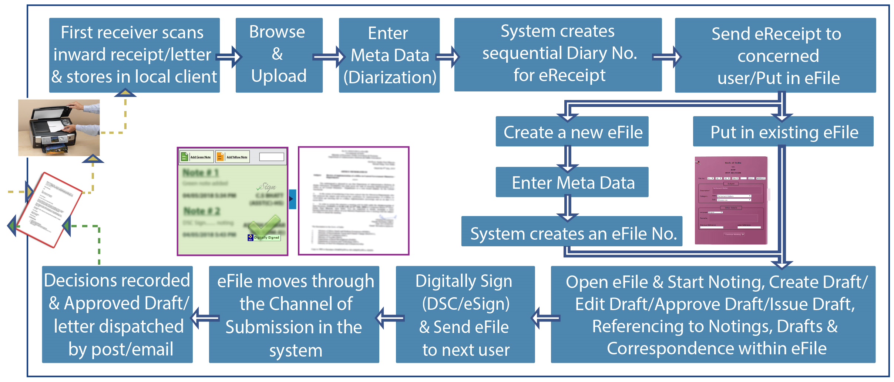
eFile Process

Slide 7
eFile7 New Features
Just been regular upgrade like previous upgrades but a lot of new UI features in this version.
First Version of eFile was release in 2009.
Like windows tab now we can work on multiple files (Requirement from many clients).
Common Inbox feature for all posts.
Multiple Signing On Draft(eg : Minutes Of Meeting).
Localization is now available(ie User can display all labels in regional language as well along with English.
More Context Menus for handling File operations.
Responsive Design(iPad, desktop, tablet)

Slide 8
eFile7 New Features(Contd.)
Seamless Viewing of multiple documents.
Inbox elegantly organized(Flagging of important files etc)
Working on multiple Files/Receipts using Tabbed View.
More area for read/write operations.
Paragraph Referencing(Referenced Paragraph will be highlighted)
We get "All" link to enable common inbox after clicking on the name at top right corner.
"Marked To" column added in common Inbox view.
Inbox By Default provides Column View. We can switch it to "Row View" as well.

Slide 9
eFile7 New Features(Contd.)
When we right click on against any file, contextual menu will appear giving us few options like Open, Open in New Tab, Send, Send Back
Star Notation is provided to mark important files, later on they can be filtered.
Filters can be now applied on many parameters.
In Sent By column when we click on username, it will give his/her complete details in eOffice.
In receipt section while filling meta-data if we select "Add to address book", it will provide 3 scopes which are self, section, department and instance.

Slide 10
eFile7 New Features(Contd.)
Now we have close button for receipts as well in Created Section. Ie We can close receipt without even moving it in the channel.
If accidently Physical receipt created then now it can be easily converted into Electronic receipt by using "convert" option.
Earlier we had separate link to choose between Physical/Electronic, SFS/Non-SFS options now we have One single link of "Create" which will provide us all selections on single page(Common creation page).
Files can be closed now from "Created" section without moving file in the channel.
Now user can create part file even if file is in " Created" or "Inbox".

Slide 11
eFile7 New Features(Contd.)
Earlier when we created new Noting, previous notings get reflected in right pane but now when user create new note previous notings are visible just above it.
New Note Typing window size is adjustable(Toggle Button).
Draft Document Link opens Draft document immediately. If there are multiple drafts then next and previous button will be enabled automatically.
For reference Contextual menu has been provided which provides 3 options: Refer this note, Refer this paragraph or Download this note(Subjected to appropriate role)

Slide 12
eFile7 New Features(Contd.)
Earlier referencing was not possible in yellow note but now referencing can be done in yellow note as well.
Details tab now provides complete history of file like Parked/Unparked, Audit, Closed, Part etc.
While creating Draft now we will get " Enable Multi Sign" checkbox.
In earlier eFile, while creating draft recipients details were mandatory to fill but now it is optional. We can fill recipient details later on.
Drafts can be dispatched to "Public", "Intra eOffice" and "Inter eOffice".

Slide 13
eFile7 New Features(Contd.)
Email and SMS option will be visible in dispatch only when both mobile and email added when adding recipient details.
Advanced Search Viewing area is customizable.
Advanced Search results can be filtered further.
Regional Language dropdown given at top right corner which will customize all labels as per selection.

Slide 14
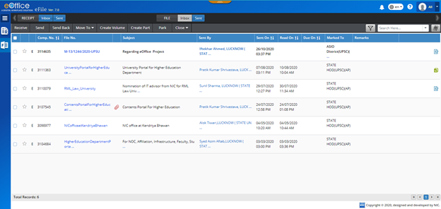
eFile – Common File Inbox

Slide 15
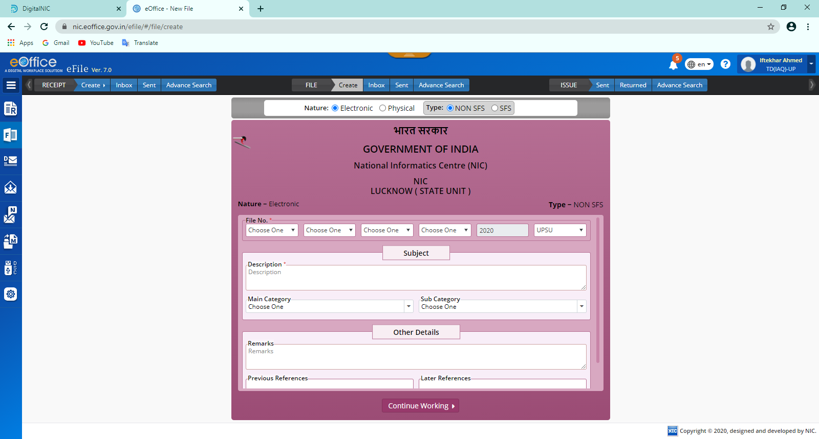
eFile – Electronic File Cover Page

Slide 16
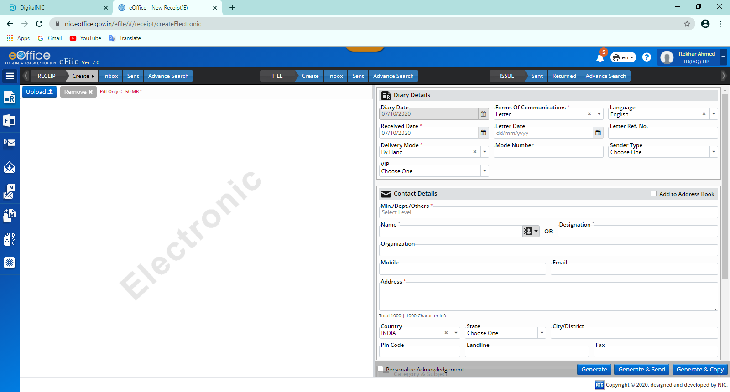
eFile – Create Receipt Page

Slide 17
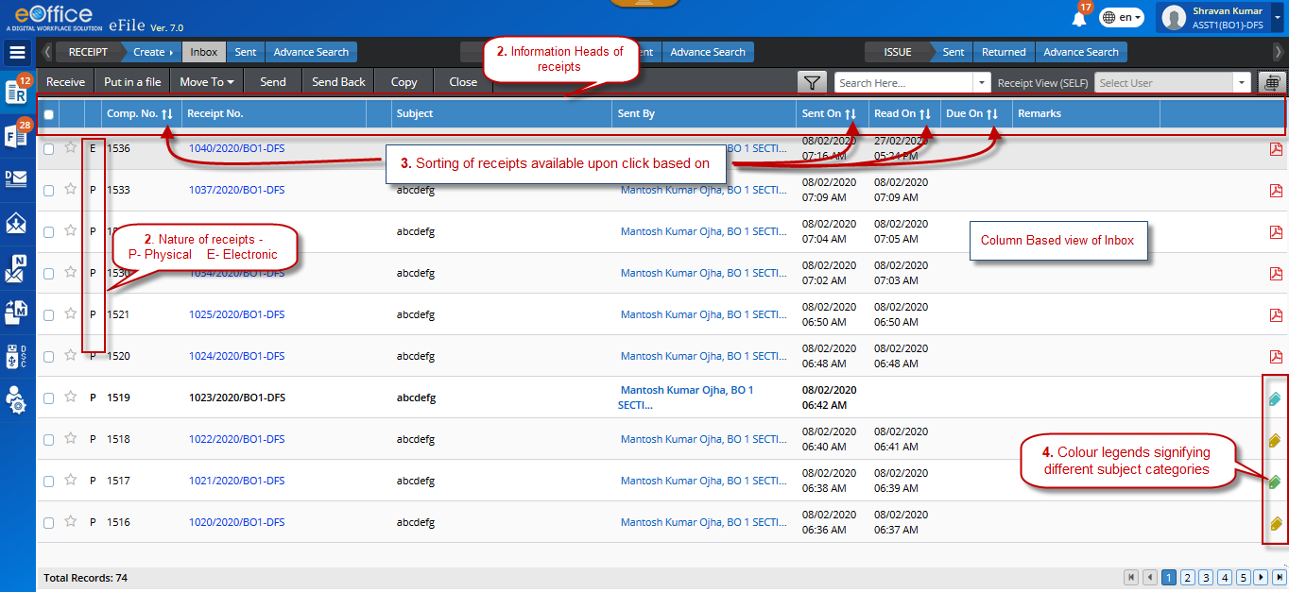
eFile –Receipt Inbox Page

Slide 18
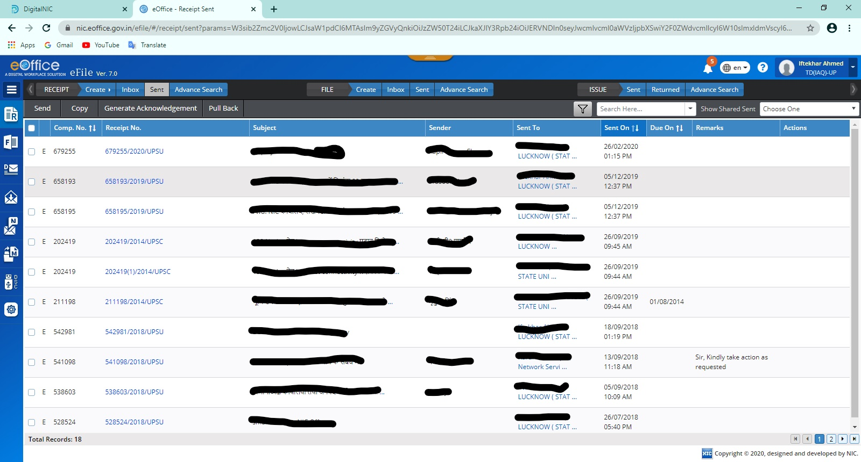
eFile –Receipt Sent Items Page

Slide 19
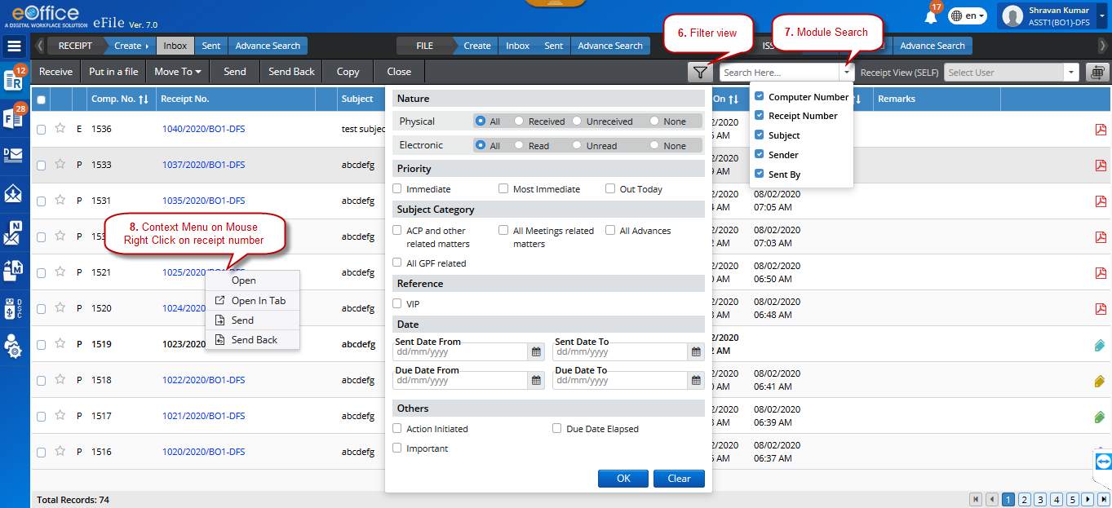
eFile – Receipt Context Menu

Slide 20
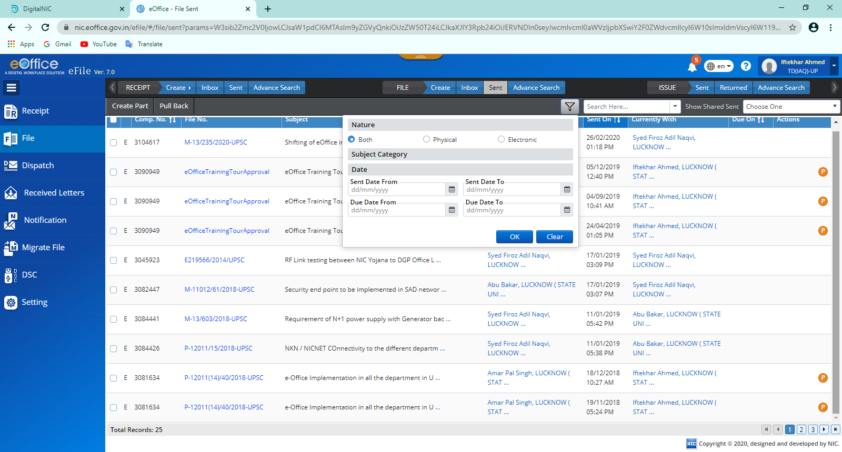
eFile –eFile Filter Page

Slide 21
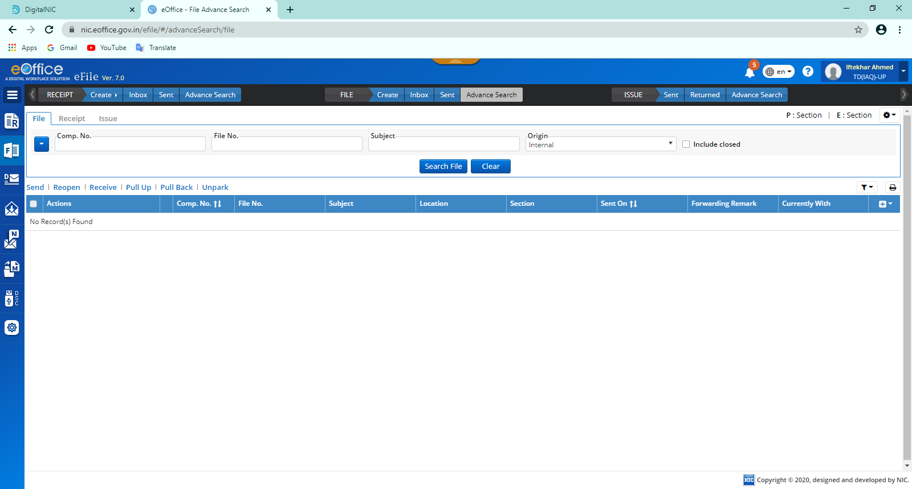
eFile –eFile Advanced Search

Slide 22
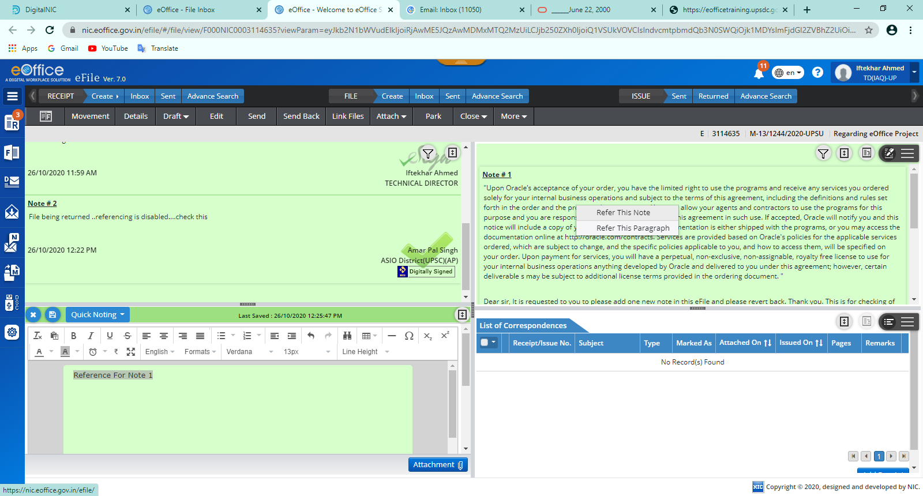
eFile –Referencing

Slide 23
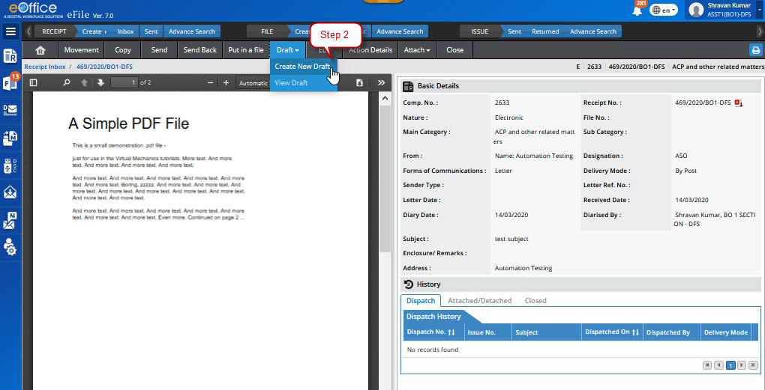
eFile –Draft Creation

Slide 24
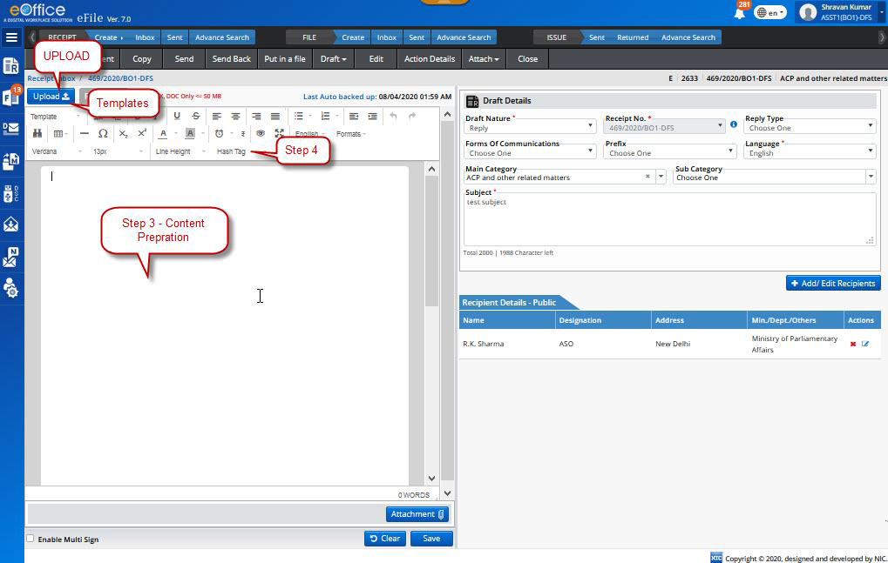
eFile –Draft Creation(Contd.)

Slide 25
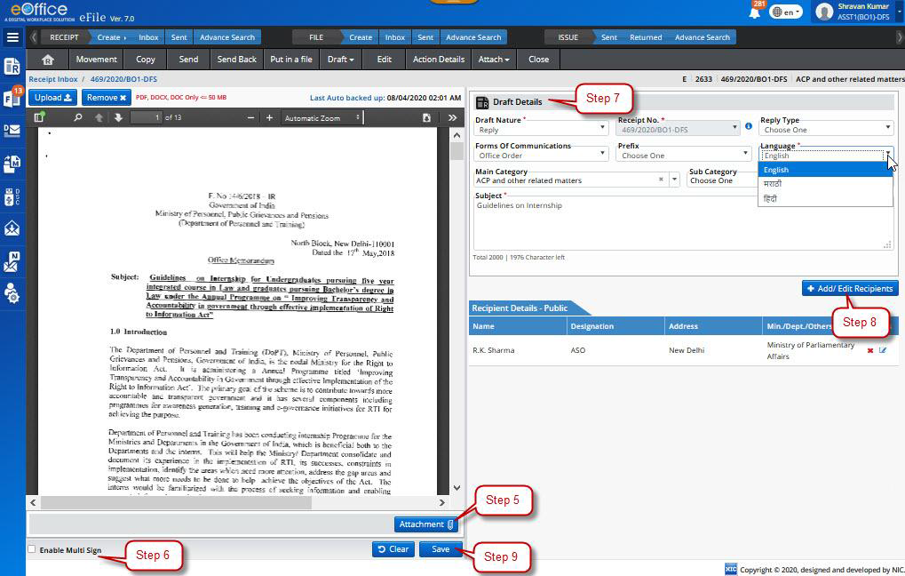
eFile –Draft Creation(Contd.)

Slide 26
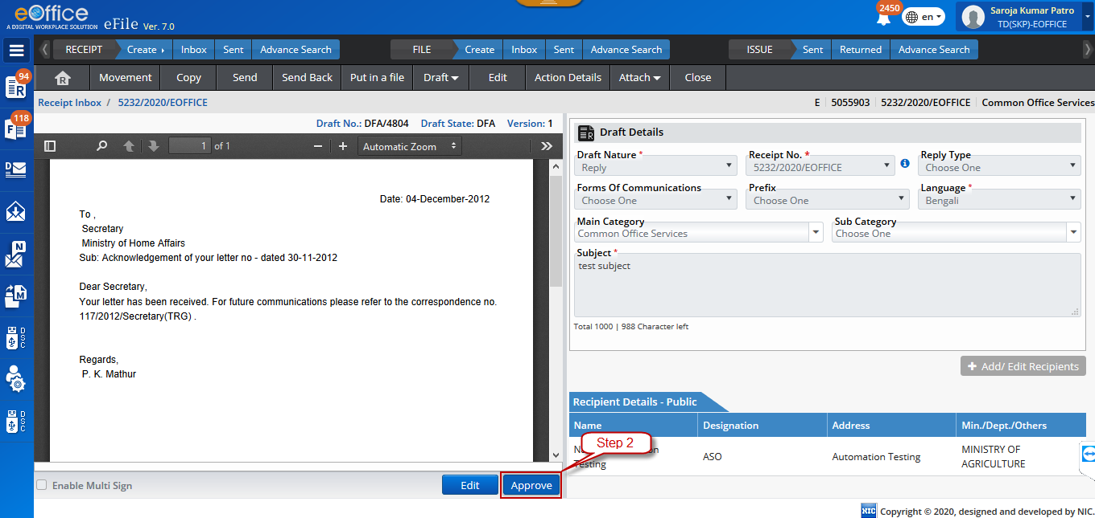
eFile –Draft Approval

Slide 27
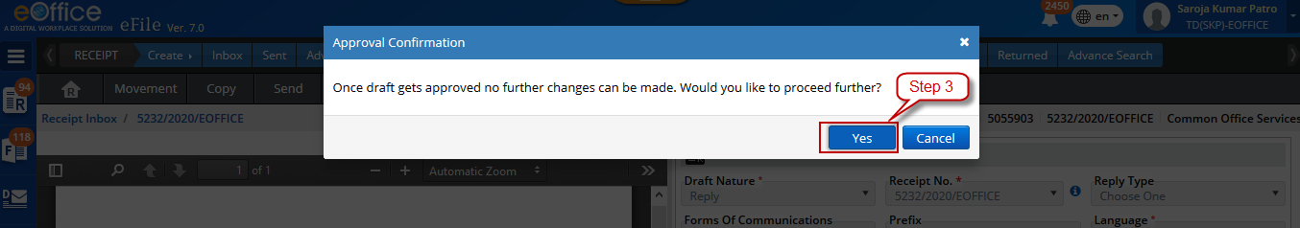
eFile –Draft Approval(Contd.)

Slide 28
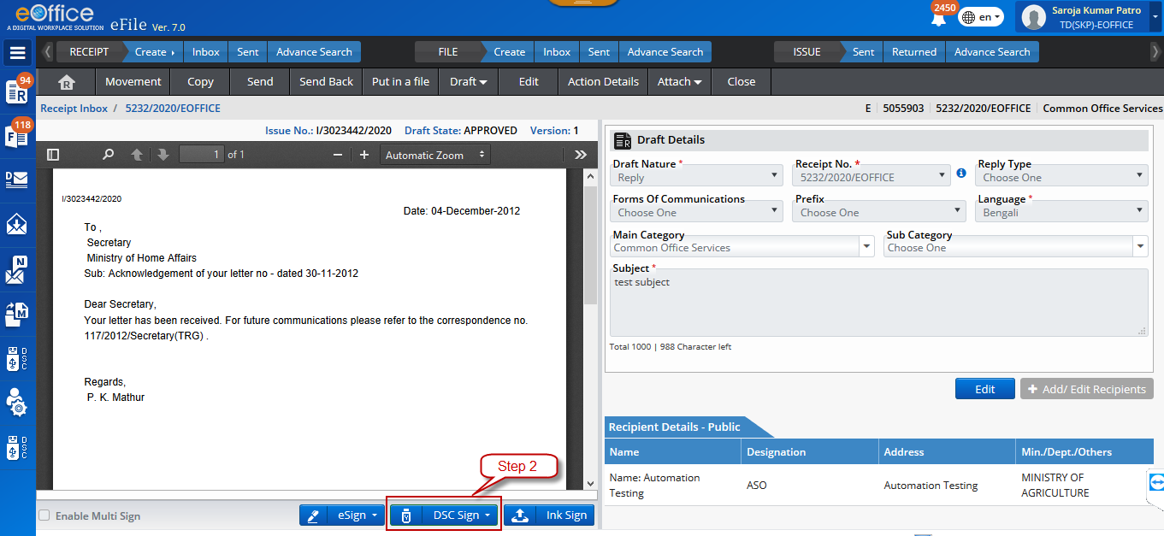
eFile –Draft Signing

Slide 29
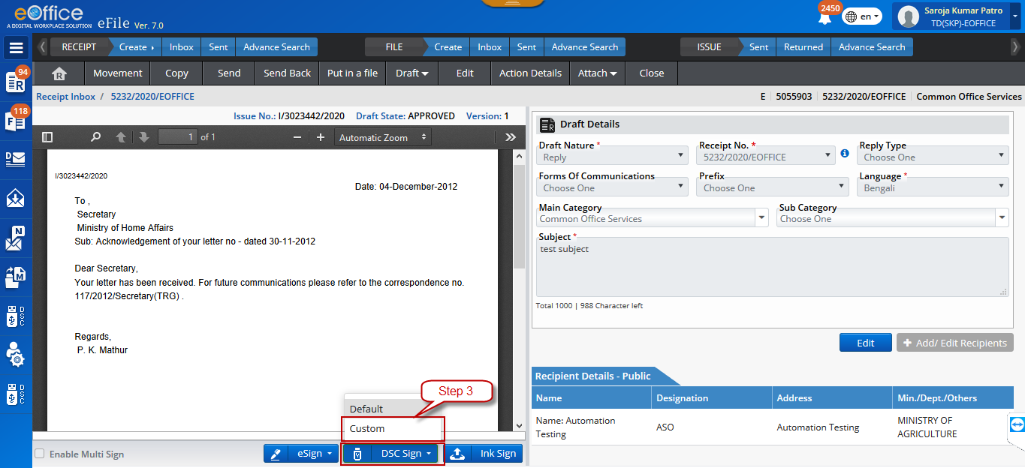
eFile –Draft Signing(Contd.)

Slide 30
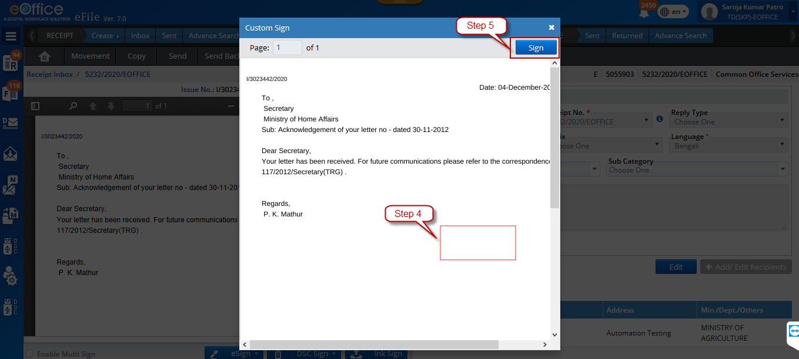
eFile –Draft Signing(Contd.)

Slide 31
THANK YOU

Slide 32

eOffice Technology Stack
Presented By
A.P. Singh, Scientist-F
Iftekhar Ahmed, Scientist-E

Slide 33
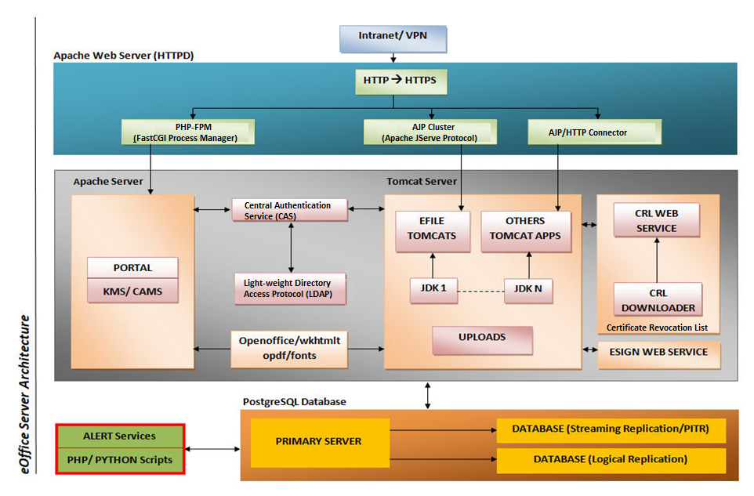
Technological Architecture

Slide 34
N-Tiers Architecture
User Layer-Browsers/Desktop Utilities/Mobile Devices/XML
Web Layer-Apache HTTPD Server
Business Logic Layer/Application Layer- PHP/Tomcat Server
Authentication Layer-LDAP Authentication/CAS
Database Layer- PostgreSQL – a restricted zone

Slide 35
Software Stack
Open source freely available stack:
Operating System – 64 Bit Linux(RHEL 7/CentOS 7.6 or above)
Web Server Apache - HTTPD 2.4.6
Database - PostgreSQL 12.2
Applications are divided into two technologies:
PHP Based Applications- Portal Dashboard, KMS, CAMS etc.
Java Based Applications- eFile, eLeave, eTour, EMD, ADMIN, etc.
For PHP based applications, we require:
  PHP-FPM
  OpenSSL, OpenLDAP etc.
For Java based applications, we require:
JDK & Tomcat
Open Office/Libre Office, Fonts, Wkhtmltopdf.

Slide 36
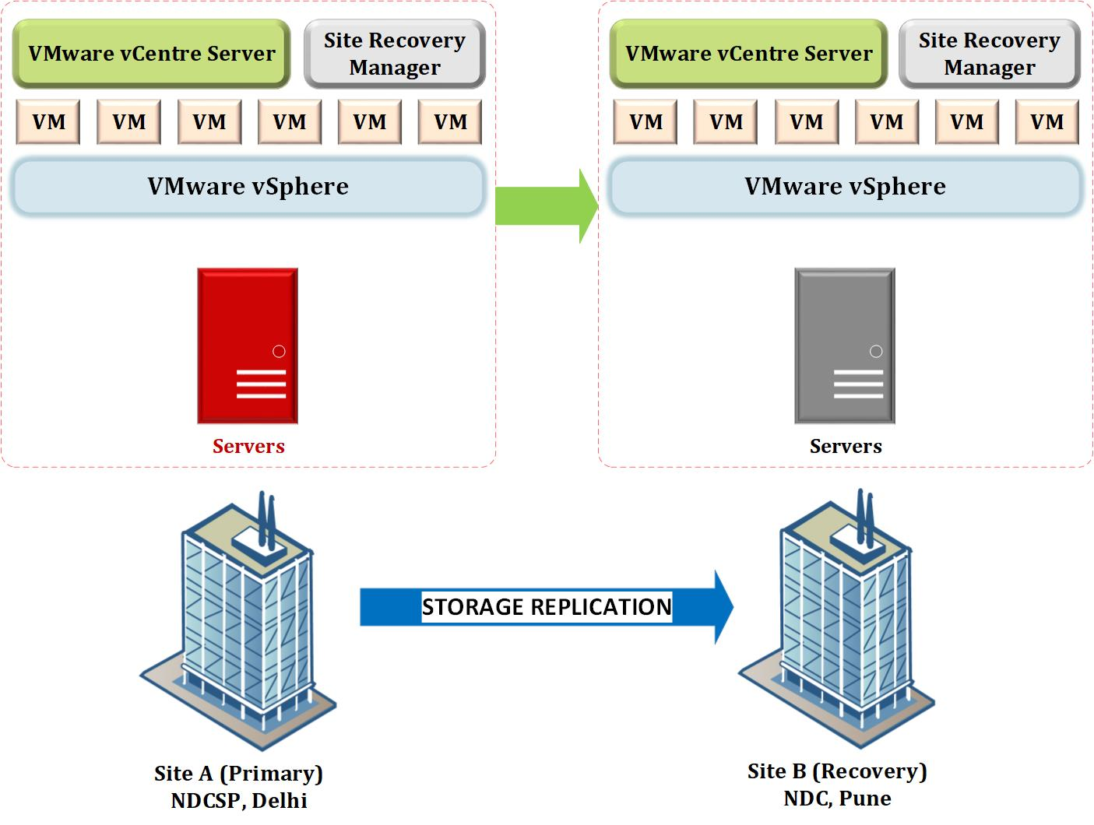
Hosting of eOffice Application
eOffice Project Division

Slide 37
Site Recovery Manager(VMware SRM)
VMware vSphere Site Recovery Manager (SRM) is a disaster recovery management product from VMware that provides automated failover and disaster recovery drill.
VMware SRM automates the process of synchronizing recovery data between the primary and backup data center sites by using
1) A third-party replication product provided by storage vendor
2) vSphere Replication to copy virtual machine data to a recovery site.
Site Recovery Manager orchestrates the recovery process with the replication mechanisms, to minimize data loss and system down time.
At the protected site, Site Recovery Manager shuts down virtual machines cleanly, if the protected site is still running.
Site Recovery Manager powers on the replicated virtual machines at the recovery site according to a recovery plan.
A recovery plan specifies the order in which virtual machines start up on the recovery site. A recovery plan specifies network parameters, such as IP addresses, and can contain user-specified scripts that Site Recovery Manager can run to perform custom recovery actions.

Slide 38
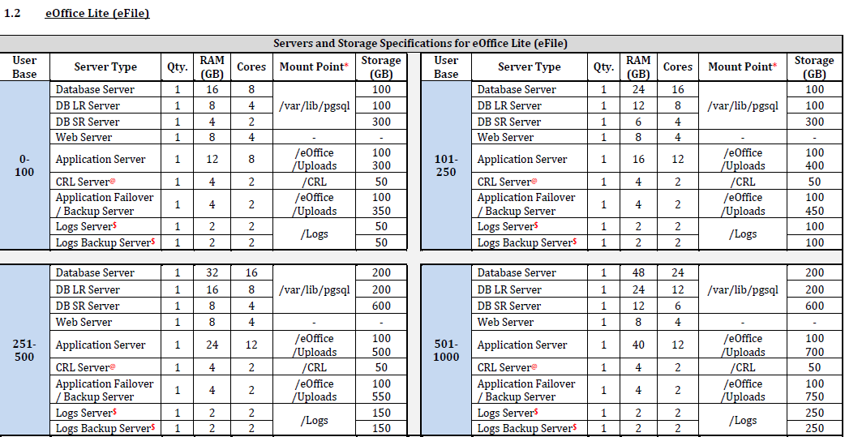
eOffice Servers and Storage Specifications

Slide 39
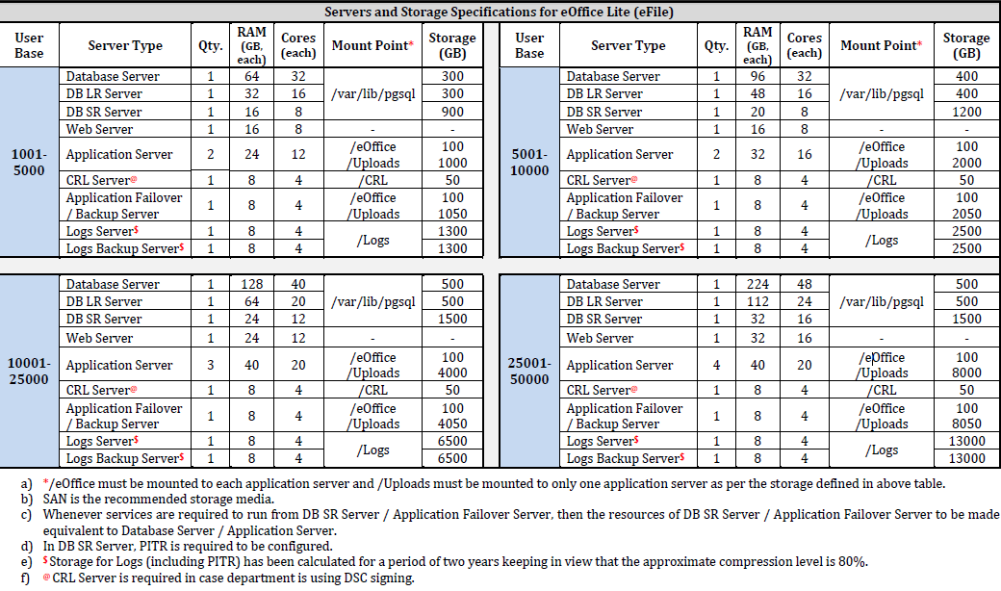
eOffice Servers and Storage Specifications

Slide 40
Apache HTTPD Server
Apache Server is a web Server. It server's job is basically to accept requests from clients and send responses to those requests.
The Apache server is set up to run through configuration files, in which directives are added to control its behavior.
In its idle state, Apache listens to the IP addresses identified in its config file (httpd.conf).
Whenever it receives a request, it analyzes the headers, applies the rules specified for it in the config file, and takes action.
To Install Apache, need to Configure Yum Server
yum install httpd* -y

Slide 41
Apache HTTPD Server: Configuration
conf is the directory where all server configuration files are located. Configuration files are basically plain text files where directives are added to control the web server's behavior and functionality.
logs is the directory where server logs are kept, and includes Apache access logs and error logs.
Current version used for eOffice is Apache HTTPD 2.4.6

Slide 42
Apache HTTPD Server: Configuration (Contd.)
The Main Configuration File: httpd.conf (/etc/httpd/conf/httpd.conf)
  1)Virtual Host Configuration
  3) Port (80 and 443)
  4) Rewrite Rule
  5) proxy Configuration
  6) Configuration for https(SSL)

Slide 43
Apache HTTPD Server: Configuration (Contd.)
Two popular connectors for Java Applications:
  1. Http Proxy: It is easy to use the standard Http proxy of Apache when single Tomcat is connected to Apache
  2. AJP Proxy: The AJP proxy is a new module based on the standard Http proxy. it uses AJP instead of HTTP.
Module: mod_proxy module is required for proxypass.
Example:
ProxyPass /App http://localhost:8080/App
ProxyPassReverse /App http://localhost:8080/App

Slide 44
Apache Monitoring and Troubleshooting
1. Apache start/stop/restart command
  apachectl start , systemctl start httpd
  apachectl stop
  apachectl restart
2. netstat is a useful command for checking process details on your server.
netstat -nelpt | grep httpd
3. counting the ESTABLISHED connections
netstat -tunalp | grep httpd | grep ESTABLISHED | wc –l
4. Apache logs
  tail -f /var/log/httpd/error_log
  tail -f /var/log/httpd/access_log
  or
  tail -f /etc/httpd/logs/error_log
  tail -f /etc/httpd/logs/access_log

Slide 45
PHP-FPM
High-performance PHP on apache httpd 2.4.x

Slide 46
Apache HTTPD Server: Configuring PHP-FPM
FastCGI was introduced as a middle ground between the PHP Apache Module and the CGI application.
It allows scripts to be executed by an interpreter outside of the web server and includes the security benefits of CGI but doesn’t include any of the inefficiencies of CGI.
When executing PHP scripts with FastCGI each request is passed from the web server to FastCGI via a communication socket.
This allows for much greater scalability as the web server and the PHP interpreter can be split into their own individual server environments if necessary.

Slide 47
Apache HTTPD Server: Configuring PHP-FPM
Pros
Improved security as PHP code execution is isolated from web server.
Static content will not be processed by PHP interpreter.
Allows files to be managed by your FTP user without altering permissions afterwards.
Cons
Cannot use PHP directives in .htaccess. This is expected by many popular scripts.
Requires PHP requests to be passed from web server.

Slide 48
Apache HTTPD Server: Configuring PHP-FPM
Step 1: Install php-fpm rpm for running php with apache ( event mpm) on the same server
# rpm -ivh php-fpm-5.4.16-36.el7_1.x86_64.rpm (installation version based on PHP-COMMON version)
Step 2: Then start the php-fpm service
# systemctl start php-fpm
# chkconfig php-fpm on or systemctl enable php-fpm

Slide 49
Apache HTTPD Server: Configuring PHP-FPM
Step 3: Then write the rule in HTTPD file
# vim /etc/httpd/conf/httpd.conf
Listen 50
<VirtualHost *:50>
ServerName SERVER_IP
RewriteEngine On
ProxyRequests Off
ProxyPreserveHost On
DocumentRoot /eOffice/eofficev6/Portal
<Directory /eOffice/eofficev6/Portal>
Options +Indexes +FollowSymLinks +MultiViews
AllowOverride All
Require all granted
</Directory>
<FilesMatch \.php$>
SetHandler "proxy:fcgi://localhost:9000"
</FilesMatch>
</VirtualHost>

Slide 50
Apache Tomcat: Configuration, Monitoring and Troubleshooting

Slide 51
Apache Tomcat
Tomcat is a Servlet container (Web server that interacts with Servlets) developed under the Jakarta Project of Apache Software Foundation
Tomcat implements the Servlet and the Java Server Pages (JSP) specifications of Sun Microsystems
Tomcat is an open-source, non commercial project Licensed under the Apache Software License
Tomcat is written in Java (OS independent)
eOffice currently uses Tomcat 7.x and moving to Tomcat 8.x

Slide 52
Tuning JDK
The JAVA_HOME environment variable points to the directory where the Java runtime environment (JRE) is installed on your System.
JAVA_HOME=/eOffice/JApps/JDK-x
Multiple JDKs are installed and configured for eOffice Tomcats.
JAVA_OPTS is the standard environment variable that some servers and other java apps append to the call that executes the java command.
JAVA_OPTS="-Djava.awt.headless=true Dfile.encoding=UTF-8 -server -Xms1048m -XX:NewSize=736m -XX:PermSize=736m -XX:+DisableExplicitGC -Dhttps.protocols=TLSv1.1,TLSv1.2"
These variables can be set in Tomcat’s catalina.sh file
Note: It is recommended to use JDK version 8 with eFile tomcat’s to achieve best performance of the eFile application.

Slide 53
Tuning Tomcat
HTTP NIO Connector
In the HTTP connector section (port 8080), replace :
protocol="HTTP/1.1"
Change with :
protocol="org.apache.coyote.http11.Http11NioProtocol"
You can also do the same thing for HTTPS connector (port 8443) if you are using SSL connections.
AJP NIO Connector
In the AJP connector section (port 8009), replace :
Protocol="AJP/1.3"
Change with :
Protocol="org.apache.coyote.ajp.AjpNioProtocol"

Slide 54
Tuning Tomcat Application
# vi /eOffice/JApps/APPS/EFILE/war-deploy/eFile /META-INF/context.xml
<Context path="/eFile" reloadable="true" crossContext="true“ useHttpOnly="false">
<Resource name="jdbc/efileDB" auth="Container" type="javax.sql.DataSource"maxActive=“300" maxIdle="30" maxWait="10000“username=“eoffice" password=“eoffice" driverClassName="org.postgresql.Driver"url="jdbc:postgresql://DBServerIP:5432/DBName"/>
</Context>

Slide 55
Tomcat Monitoring Commands
1. Tomcat start/stop/logs command
/eOffice/JApps/Tomcat/EFILE-LB1/bin/startup.sh
/eOffice/JApps/Tomcat/EFILE-LB1/bin/shutdown.sh
/eOffice/JApps/Tomcat/EFILE-LB1/bin/catalina.sh start/stop
2. netstat is a useful command for checking process details on your server.
netstat -nelpt | grep java
3. To check the internal connection
  elinks http://localhost:5050/eFile
  elinks http://localhost:5051/eFile
4. Tomcat logs
  tail -f /eOffice/JApps/Tomcat/EFILE-LB1/logs/catalina.out
  Note : in eOffice all Logs are stored in centralized location /eOffice/Logs Directory whether it is Tomcat’s Logs or Apache Logs or System Logs

Slide 56
Tomcat’s Used in eOffice
Name Of Tomcat Server | Purpose
EMD | This Tomcat is responsible for managing Employee Master Data
MIS | This Tomcat is responsible for reports which are generated for Management Information System.
ADMIN/MDM | This Tomcat is responsible for managing Master Data like File Heads, File Code, File Head Mapping, Ministry etc.
CRL | This Tomcat manages Certificate Revocation Lists(For DSC validation)
EFILE | There are two Tomcat’s which are managing eFile application by using Load balancing by busyness.
PERCAS/SSO | This Tomcat manages communication between LDAP and Centralized Authentication Services.

Slide 57
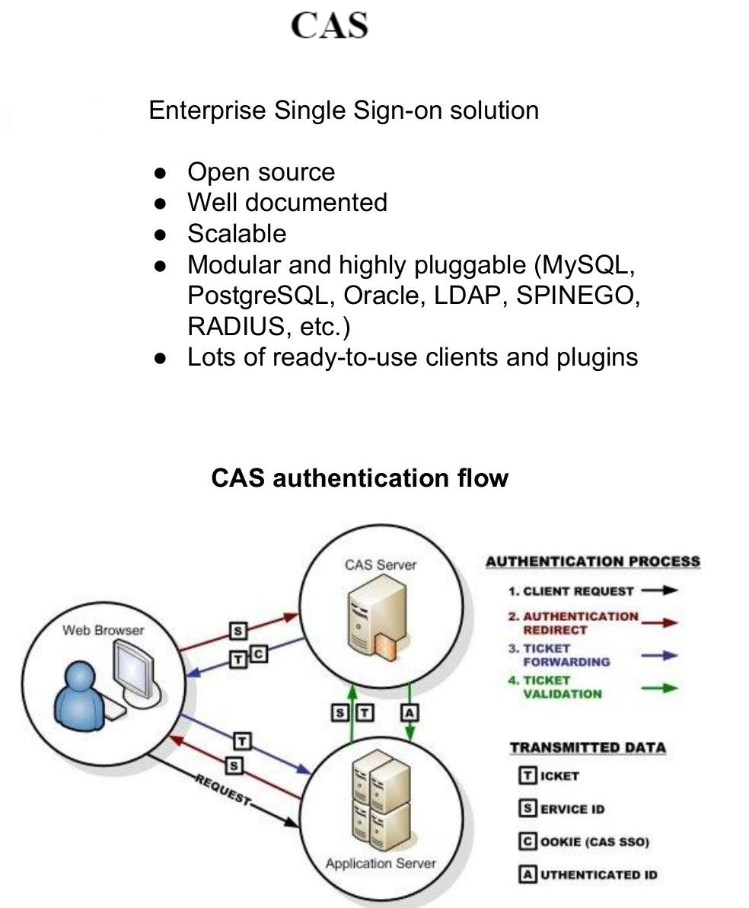
Central Authentication Service(CAS)

Slide 58
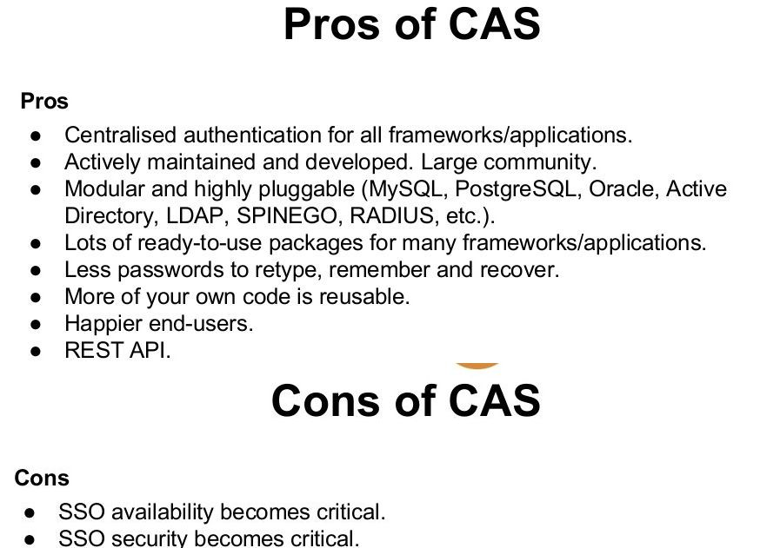
Central Authentication Service(CAS)

Slide 59
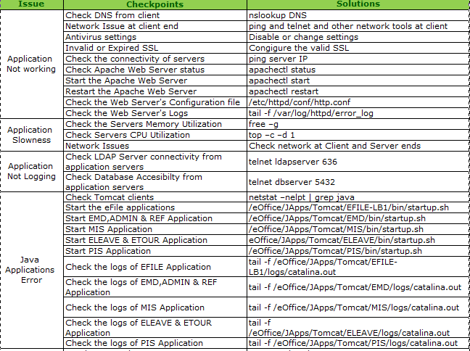
eOffice Troubleshooting Checklist

Slide 60
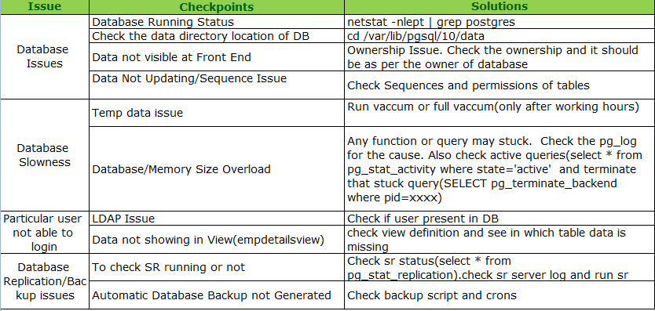
eOffice Troubleshooting Checklist(Contd.)

Slide 61
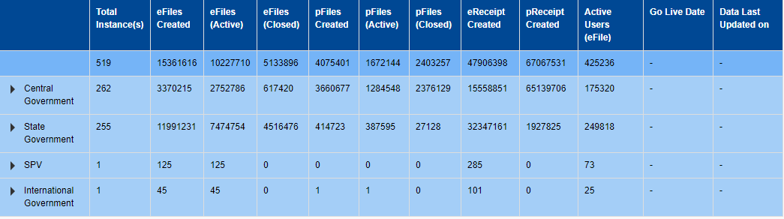
eOffice Dashboard

Slide 62
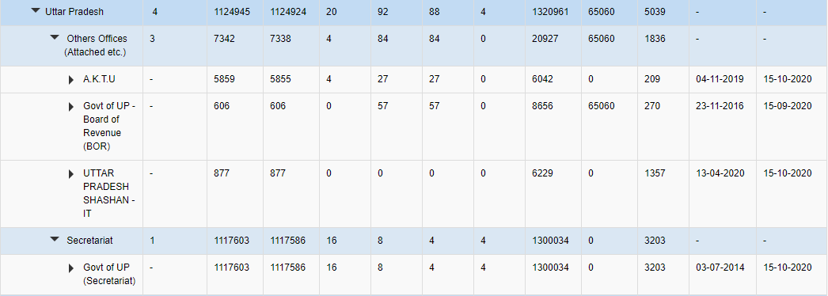
eOffice in Uttar Pradesh

Slide 63
eOffice On Boarding Steps

Slide 64
GoI/NIC Mail ID is required to login in eOffice using LDAP (Light Weight Directory Access Protocol) Authentication.
Steps for Getting GoI/NIC email ID:
User can fill the form for email account creation (individual) or in (bulk) using the following link:
  https://eforms.nic.in
Guidelines while applying GoI/NIC eMail ID:
All the fields must be filled.
2. Date Format should be dd/mm/yyyy. (eg : Date Of Birth, Date of Retirement)
Creation of GoI/NIC Email IDs

Slide 65
Bulk Email CSV File Structure
First Name*
Last Name*
Designation*
Department*
State*
Country code
Mobile no.
Date of Retirement / Completion of Contract(Contractual employees / Consultants)(Format DD-MM-YYYY)
Login UID
Complete Email address
Date of Birth (Format DD-MM-YYYY) Optional
Employee Code (Optional)

Slide 66
Procurement of Digital Signature Certificates
Digital Signature Certificate (DSC) is required for digital signing the note sheet and draft for approvals (DFA) in File Management System (eFile).
It can also be used as a mode of authentication for logging in to eOffice along with GoI/NIC eMail Ids.
Class-2 DSC with Signing Certificate are recommended for eOffice.
For procurement of Digital Signature Certificate, user department may directly approach to UPLC or UPDESCO or other vendors who are providing DSCs.
The user department can also approach any Certifying Authority (CA) for procurement of DSC.

Slide 67
NIC/NICNET Connectivity
Client has to apply for NIC/NICNET Connectivity
It is mandatory to have NIC/NICNET Connectivity in order to run eOffice. eOffice is not accessible outside NICNET(Due to security concerns)
NIC will provide an IP to the client for NICNET connectivity. This IP needs to be configured on Client’s Firewall with the help of local Vendor.
Note : NIC does not provide Internet Connectivity. NIC will provide intranet IP for accessing eOffice application and needs to be configured on client’s firewall.
Note : The cost of leased line, router, switches or any other equipment required for connectivity shall be borne by user department.

Slide 68
Employee Master Data (EMD) Template
Client needs to provide it’s employee data in following excel sheets.
Designation Master
Post Master
OU Master
EMD Master

Slide 69
EMD Templates
Designation Mater
S.No.
Designation Name *
Designation Code *
Designation_Rank *
Service Group *
Designation Description *
Is_Gazetted
Designation Name in Hindi
Designation Name in regional Language
Post-Master
S.No.
Post Name *
Post Code *
Post Description *
Post Name in Hindi
Post Name in Regional Language
EMD
S.No
Title *
Employee Full Name *
Gender
Employee Code*
Designation of employee *
NIC Email *
Name of Organization unit*
Post Name*
Marking Abbreveation*
Name of Reporting Officer OU*
Name of Reporting Officer*
Reporting-markingabbr. (Parent Post)
Remark (If Additional Post)
OU-Mater
S.No.
Name of Organization unit *
Organization Code *
Entity Type *
Parent Organization Unit Name *
File Code *
Organization Description
OU Name in Hindi
OU Name In Regional Language

Slide 70
File Head Template
Client needs to provide it’s File Head data in following format:
File heads can be divided in following categories:
    Basic Head (<= 6 Characters)
    Primary Head (<=4 Characters)
    Secondary Head (<=4 Characters)
    Tertiary Head (<=4 Characters)
Note: There should not be any special characters(/,&,\,-,_*) in heads.

Slide 71
THANK YOU

